Slide 1
Intro to Jekyll
Notes:
Who here has considered trying out a new tool to improve the way you work?
Any of you have considered Jekyll specifically? Why?

Slide 2
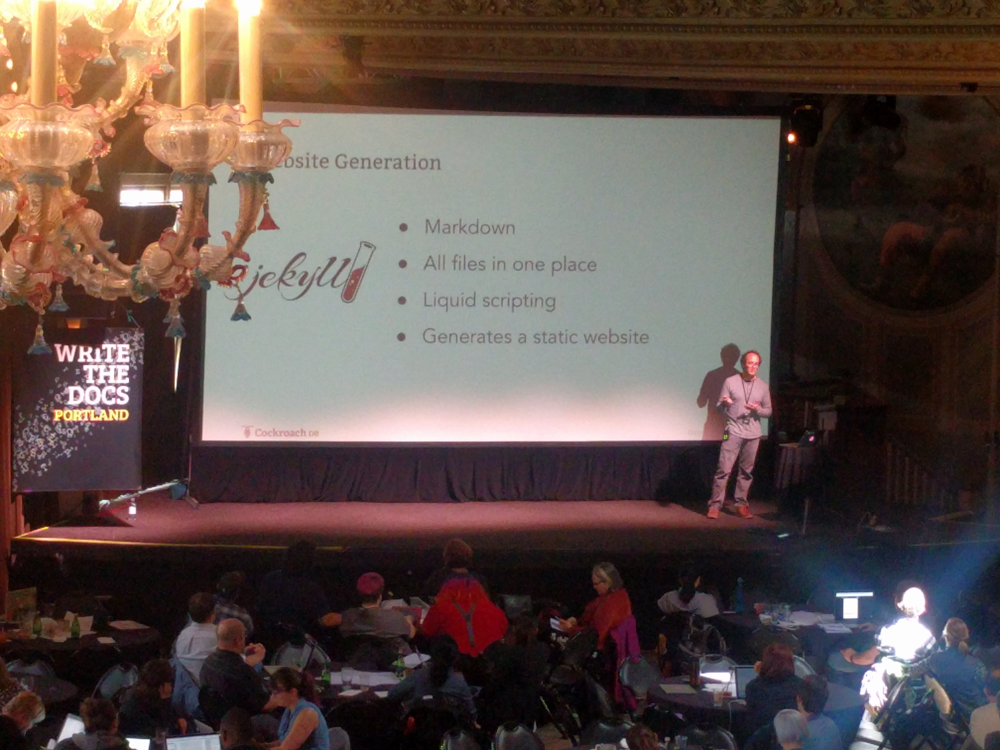

Before we begin
Why Jekyll?
Notes:
What got me interested in Jekyll:
Was newbie tech writer, went to WTD Portland, heard about docs-as-code, wanted to try it for myself
Previous experience with MadCap Flare and variety of CMSs
Wanted to get experience with new tools and practices, very pumped up about Jekyll and docs as code
In restrospect, I wish I’d had someone more experienced to help me prepare. Hopefully I can accomplish that with this talk.
What’s got you interested in Jekyll?
What are you hoping to learn from this talk? (I can cover some, and point to other resources for the rest)

Slide 3
Why Jekyll?
Documentation as code
Lightweight
Free and open source
Notes:
Documentation as code
Use developer tools and methodologies, for example do doc reviews directly in files in GitHub or GitLab
Lightweight
Not as cumbersome as using a CMS or tool with a GUI
Free and open source
Use for free, add extensions, plugins, customize as needed, active community

Slide 4
We’ll cover
Jekyll overview
How to use Jekyll as a Help Authoring Tool
What I wish I’d known before adopting Jekyll
Additional resources
Notes:
Disclaimer: We will not cover installation or setup! All of these examples are based on a working repo.
Disclaimer 2: I approach this from perspective of a tech writer, not a developer or Jekyll super user.

Slide 5
Jekyll overview
Notes:
To demonstrate this, we’ll be referring to Tom Johnson’s Jekyll theme
Open TJ’s theme.
Open Atom, show project files
Open CL, serve site, continue while it generates

Slide 6
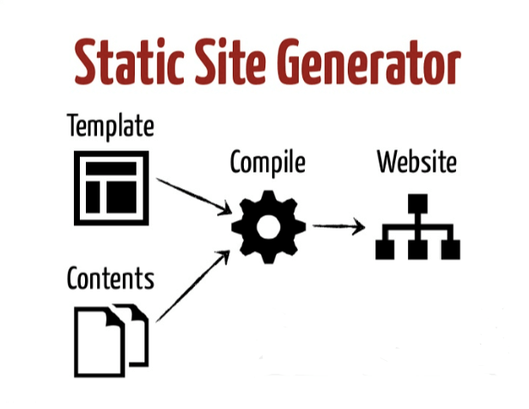
What is Jekyll?
A static site generator
Used as a Help Authoring Tool (HAT), or as part of a tool chain
Notes:
What is a static site generator?
A static site is a collection of pages contained in basic HTML files. You could hand-write these in a text editor, but managing assets and repeated elements such as navigation can become problematic.
A static site generator (SSG) is a compromise between using a hand-coded static site and a full CMS. You generate an HTML-only website using raw data (such as Markdown files) and templates. The resulting build is transferred to your live server.

Slide 7
Basic usage
Write content in Markdown
Customize page layouts with Liquid and YAML (and more!)
Modify styles in CSS or Sass
Convert files to a static HTML website
Notes:
Walk through a examples, eg from fork of TJ’s docs project
- Launch preview server
Update page content
Landing page
Root folder > index.md
Update some formatting
_layouts > page.html
Move h1 div from line 5 to 67
Update some YAML
_data > sidebars > mydoc_sidebar.yaml
Comment out “Release notes”, lines 46-57

Slide 8
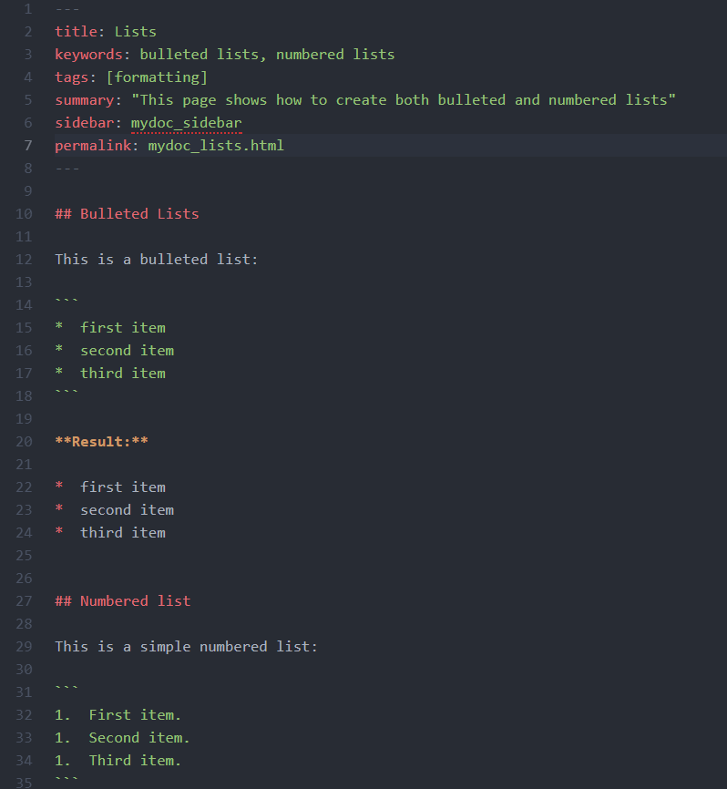
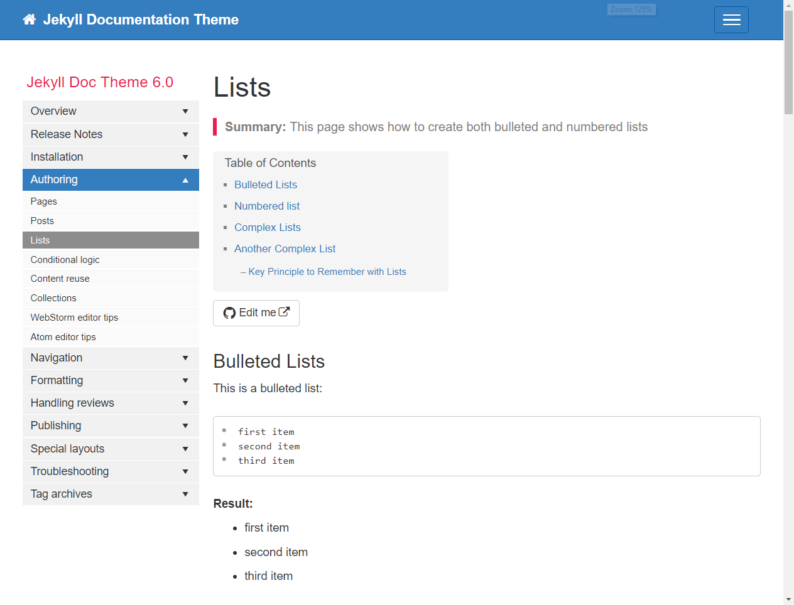
Write content in Markdown
Notes:
Add some Markdown, show it regenerate
A text-to-HTML conversion language for web writers.
Simple, human readable

Slide 9
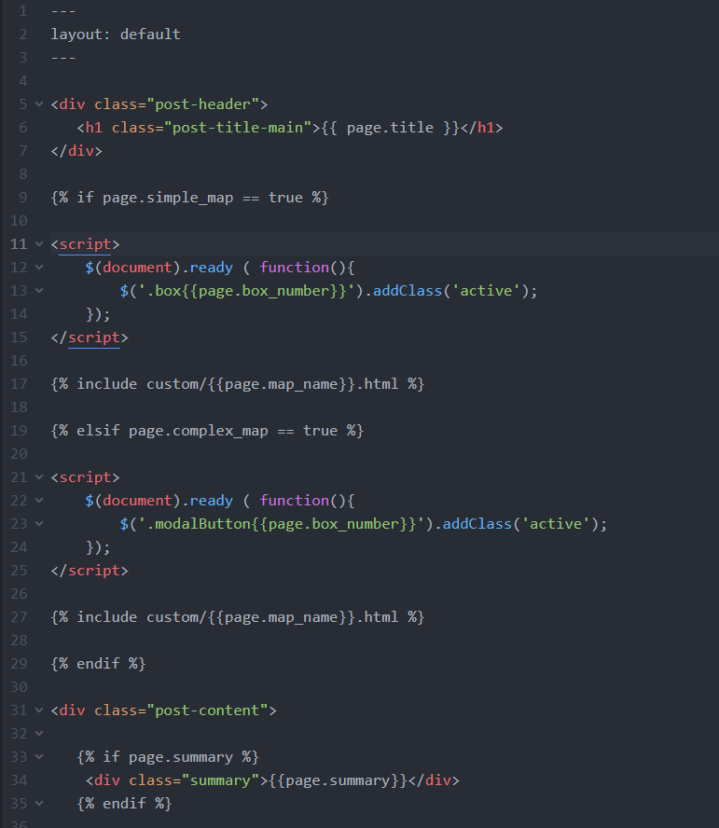
Customize layouts with Liquid
Notes:
What is Liqid?
A templating language built by Shopify
Similar to Jinja
Very good documentation available on Shopify website

Slide 10
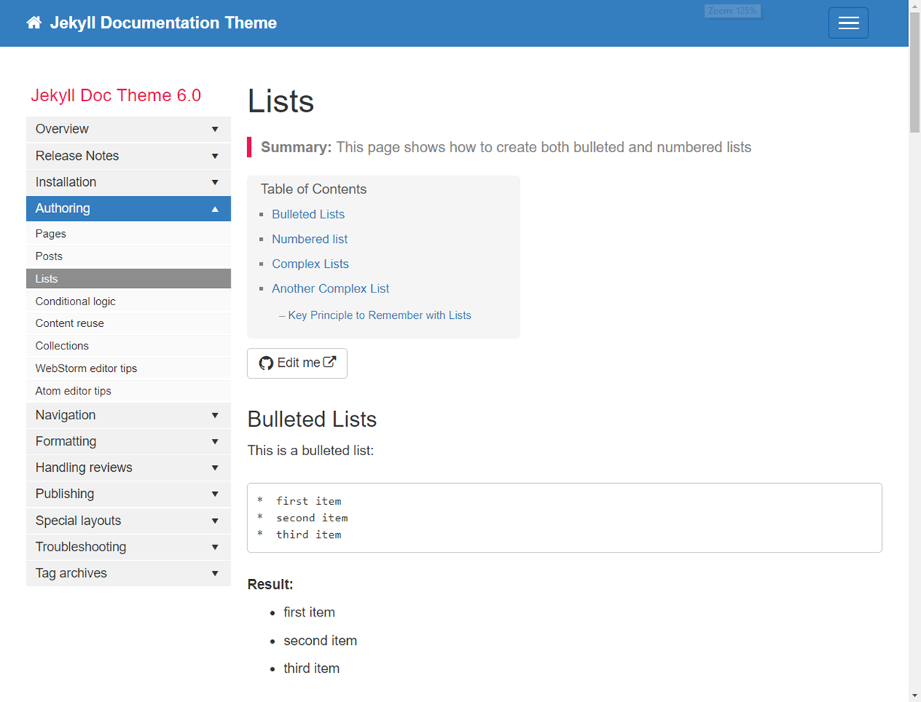
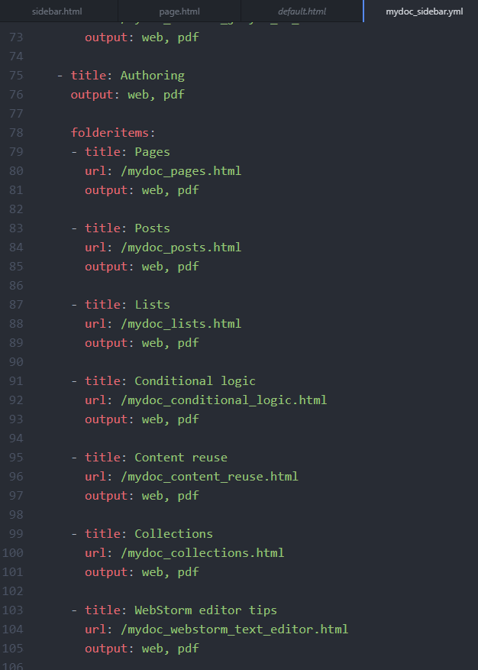
Define variables with YAML
Notes:
What is YAML?
YAML ain’t markup language
A way of formatting lists in a key-value format
Similar to JSON but rather than using markup, it’s whitespace sensitive. Helpful to use a parser.
Documentation available through Salt docs

Slide 11
YAML continued
Notes:
What is YAML?
YAML ain’t markup language
A way of formatting lists in a key-value format
Similar to JSON but rather than using markup, it’s whitespace sensitive. Helpful to use a parser.
Documentation available through Salt docs

Slide 12
Jekyll as a Help Authoring Tool
Notes:
How does Jekyll compare to other HATs?

Slide 13
Comparison with MadCap Flare
MadCap Flare | Jekyll
Topics | Posts (or pages)
Intuitive graphic user interface | Folders and a text editor
WYSIWYG Editor | Live local preview
Simple cross-referencing | Manual linking
Snippets | Variables
Simple navigation | Navigation requires extra care
PDF support | No built-in PDF support
Themes optimized for software documentation | Some themes optimized for docs

Slide 14
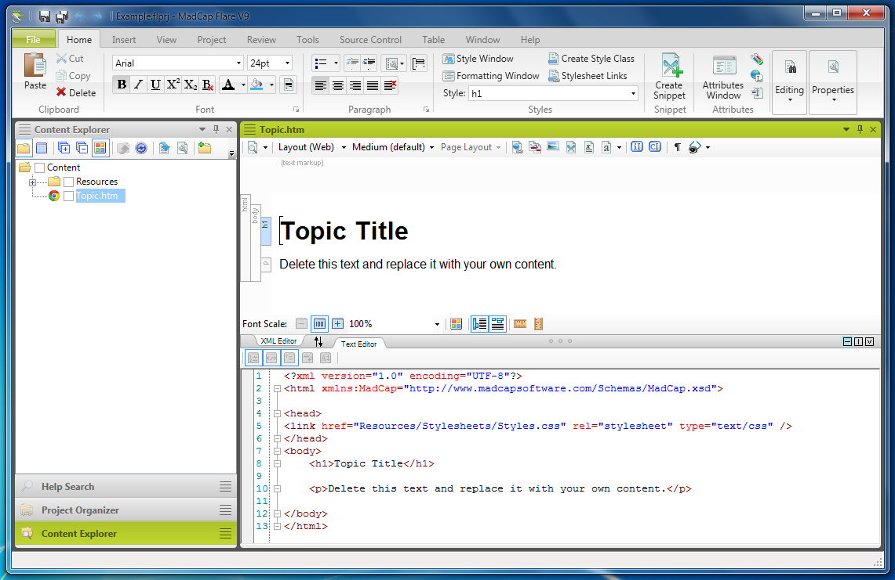
Notes:
Compare MadCap Flare interface with a Jekyll doc project

Slide 15
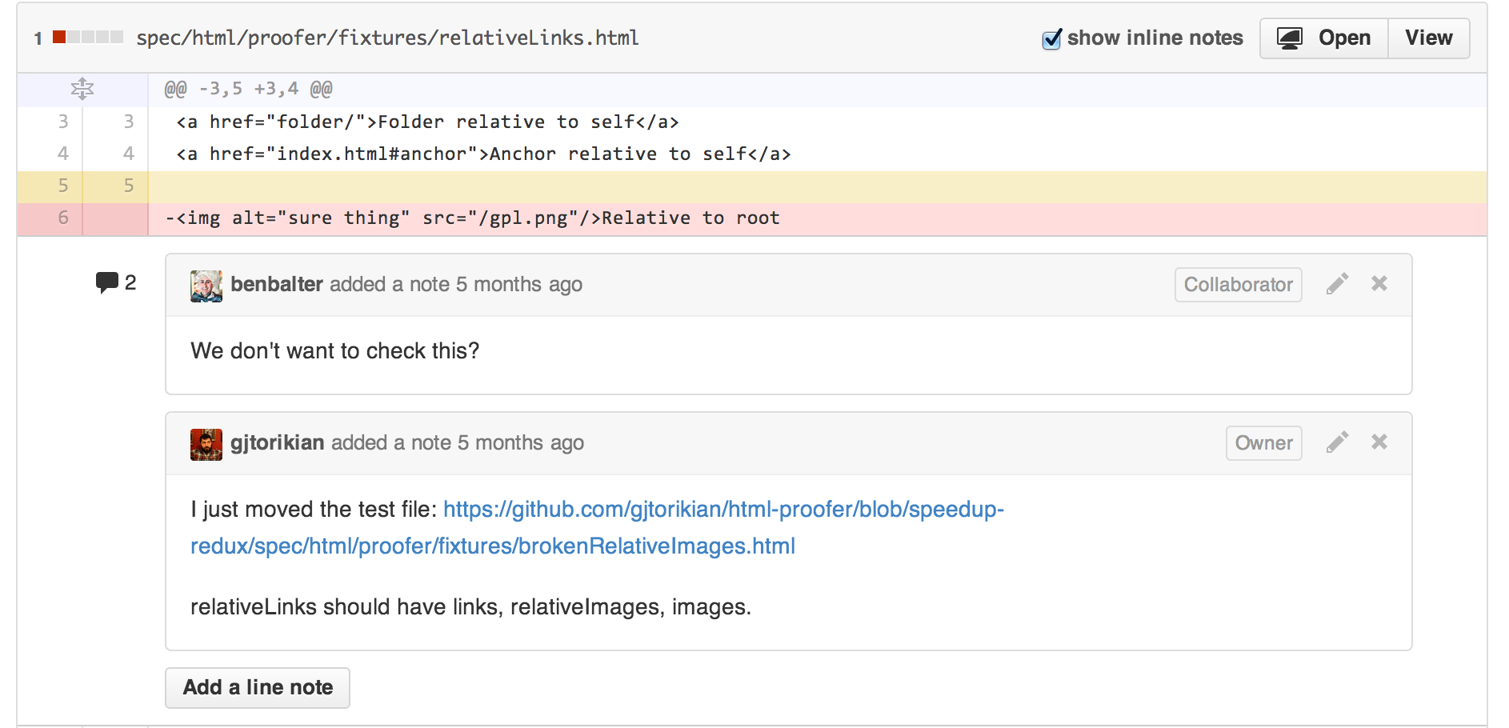

Slide 16
What I wish I’d known
Compare different themes before you pick one
Write content in pages or posts; just keep it consistent
Index pages (or posts) in a Table of Contents (using YAML)
Links get complicated – keep them organized!
Pay attention to instant compile feedback
Take advantage of developer tools
Stop and consider whether Jekyll fits your project needs
Learn Git
Budget time for unknowns
Notes:
Compare different themes before you pick one
Save yourself trouble by picking a theme with navigation optimized for a documentation project
Write content in pages or posts; just keep it consistent
Pages are probably best unless you’re writing a blog
Index pages (or posts) in a Table of Contents (using YAML)
Back it up with a spreadsheet
Links get complicated – keep them organized!
Spreadsheet may come in handy again
Pay attention to instant compile feedback
Re-work your Liquid to reduce compile times
Error messages are typically clear, helpful
Take advantage of developer tools
Use GitHub or GitLab to comment directly in the files
Stop and consider whether Jekyll fits your project needs
It may be best for developer docs, less so for documenting a product with a GUI. The jury’s out on this.
Learn Git
Don’t try to wing it. Learn the ropes with a good training course (coming up next slide)
Budget time for unknowns
Unexpected issues for me included navigation bugs, inability to create PDF, and more!
Lessons I’ve learned may not all apply to your needs. You’ll likely run into your own unique obstacles. Make sure you have time and ideally access to a developer.

Slide 17
Overall conclusion
Jekyll is great for the right projects
I learned a lot!
Helpful to get experience with developer tools and processes
Notes:
Jekyll is great for the right projects
Featuring code samples
Docs that don’t include many graphics or intensive formatting needs
What’s next: Q & A
Can also live demo a few things if people are interested

Slide 18
Additional resources
Jekyll for Web Designers, by James Williamson on Lynda.com: https://www.lynda.com/Jekyll-tutorials/Jekyll-Web-Designers/383124-2.html
Jekyll tutorials by Giraffe Academy: https://www.giraffeacademy.com/static-site-generators/jekyll/
Documentation theme for Jekyll, by Tom Johnson: https://idratherbewriting.com/documentation-theme-jekyll/
Official Jekyll documentation: https://jekyllrb.com/docs/home/
Liquid reference: https://help.shopify.com/en/themes/liquid
Understanding YAML: https://docs.saltstack.com/en/develop/topics/yaml/
Jekyll forums: https://talk.jekyllrb.com/
Introducing Docs Like Code, by Anne Gentle: https://justwriteclick.com/2016/09/26/introducing-docs-like-code/
How to use Git and GitHub, by Udacity: https://classroom.udacity.com/courses/ud775

